Slide 1


INTRODUCTION TO SPaRKS2
Presented by:
Doug Backman, Doshie Walker

Slide 2

OVERVIEW
General Information
SPaRKS2 Program Framework
Course Syllabus
Exploring Research Administration…for CONCEPT to COMMERCIALIZATION
Doshie Walker

Slide 3
OVERVIEW
General Information
SPaRKS2 is 14-sessions, 6-month long professional development program
Designed around the CRA Body of Knowledge, meant to give an introduction to intermediate concepts of research administration: from Concept to Commercialization
SPaRKS2 meets biweekly June 5 – December 4
WHEN: 9am to 11am (every other Wednesday)
WHERE: University Tower, 2nd floor training room
INTRODUCTION TO SPARKS2

Slide 4

OVERVIEW
General Information
SPaRKS2 Intermediate Program is a certificate-based professional development program
To be eligible for the SPaRKS2- Certificate of Completion
Attend all SPaRKS2 sessions
Only ONE session may be missed
Missed session must be completed prior to the next scheduled SPaRKS2 session (made up within 2 weeks)
If you miss one classroom session, you can make it up by contacting the lead presenter of that session. Arrangements will be made to either meet with that person and/or other presenter(s) of that session.
INTRODUCTION TO SPARKS2

Slide 5

OVERVIEW
General Information
Please use vibrate or silent mode
INTRODUCTION TO SPARKS2
Notes:
Doshie will collect sign in sheets and create classes in the UCF HR online training history.

Slide 6


OVERVIEW
General Information
What to expect:
SIGN IN!!! Be ON TIME!
2 hours of instruction, with a ~10 minute break
Question/Answer period, as time allows
Followed by Advanced series in the future
Interested in sitting for the CRA Exam?
CRA Study Group will be scheduled for personnel interested in siting for the Dec 2013 CRA exam.
INTRODUCTION TO SPARKS2
Notes:
Doshie will collect sign in sheets and create classes in the UCF HR online training history.

Slide 7
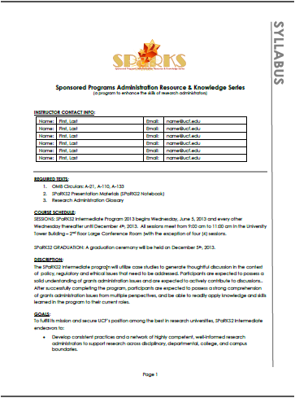
OVERVIEW
SPaRKS2 Course Syllabus
INTRODUCTION TO SPARKS2

Slide 8

QUESTIONS or COMMENTS?
Contact Information:
Doshie Walker
Coordinator, Education & Training Programs
Email: Doshie.Walker @ UCF.edu
Office: #407-882-1115

Slide 9

Exploring Research Administration from Concept to Commercialization
Module 2
A-21: Beyond Section J
Terri Vallery
Assistant Director
Office of Research & Commercialization

Slide 10

OMB A-21 FEELS LIKE THIS:
More is better than less because if stuff is not less if there’s more less stuff then you might you might want to have some more and your parents won’t let you because there’s only a little we want more we want more like you really like it we want more
It’s not complicated?

Slide 11
Section A. Purpose and Scope
Provides cost accounting principles for federally sponsored research, training, and other sponsored work
Institution sets their own cost policies that capture the cost objectives in A-21
Institutions are unique and can establish policies that best meet their mission, but still maintain adherence to A-21

Slide 12
Section A. Purpose and Scope
Does not apply to:
Federal financing for loans, scholarships, fellowships, traineeships when such items are based on education allowance or published tuition rates/fees
Capitation awards
When “conditional exemptions” apply under statutorily authorized consolidated planning & administrative funding – ex. HUD
When states adopt OMB A-87

Slide 13
Section B. definition of terms
Major Functions
Sponsored Agreement
Allocation
Facilities and Administrative Cost

Slide 14
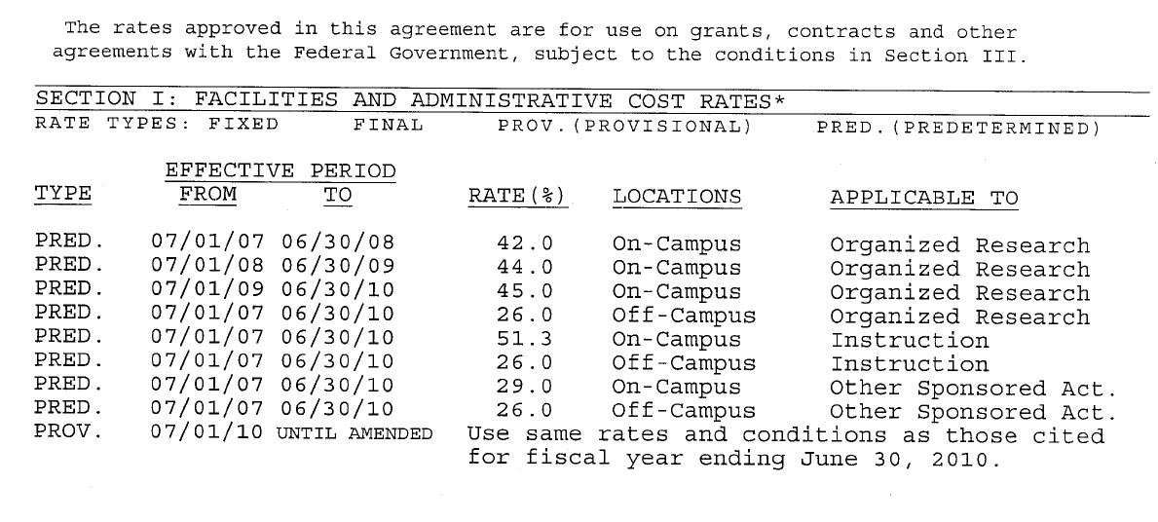
Section B. Definition of Terms

Slide 15
B.1. Major functions
Instruction
Teaching and training activities
Departmental research (no separate budget)
Sponsored Instruction and Training
Established by grant, contract, or cooperative agreement
Can be either a major function or included in instruction
51.3 percent and 26 percent
Max Poole / Alfred P Sloan Foundation
Implementation of 16 Professional Science Master’s programs in the State of Florida

Slide 16
B.1. Major functions
Organized Research
University/Department Research (separate budget)
Sponsored Research
R&D funded by Federal and non-Federal sources
Training of individuals in research techniques
Must use same facilities as R&D and not be considered instruction
45 percent and 26 percent

Slide 17
B.1. Major functions
Other Sponsored Activities
Work sponsored by Federal and non-Federal sources that are not considered Instruction or Organized Research
Usually health service projects and community service programs
29 percent and 26 percent
UCF/ Florida Commission on Community Service
Improve levels of school readiness and success in two schools in Orange County

Slide 18

B.1. Major functions
Other Institutional Activities
Except other Major Functions, F&A Costs and Service Centers
Dorms, bookstores,
student union, theater,
museum, athletics,
clinics, etc.

Slide 19
Section C. Basic Considerations
How much does research cost?
Allowable direct costs needed for performance, and;
Allocable portion of allowable F&A costs,
Less applicable credits

Slide 20
Allowability of Costs
What does “Allowable” really mean?
Must be reasonable
Must be allocable
Must be given consistent treatment
Must conform to limitations or exclusions in A-21 or the agreement

Slide 21
Allowability of Costs
What does “Allowable” really mean?
Must be reasonable
Must be allocable
Must be given consistent treatment
Must conform to limitations or exclusions in A-21 or the agreement

Slide 22

c.3. Reasonable Costs
Faculty Interpretation

Slide 23


c.3. Reasonable Costs
A prudent business person would have purchased this item at this price under the circumstances of the time.

Slide 24
C.3 Reasonable costs
Necessary in performance of the agreement
Adheres to federal and state laws/regulations
Arm’s length bargaining
Consistent with institutional polices and procedures

Slide 25
C.3. Reasonable Costs
Dr. Grey received an award from the U.S. Department of Transportation to study the extent and significance of wrong-way driving on toll roads. Since wrong-way drivers may go unreported, data collection included surveying frequent toll road users asking if they had seen any wrong-way driving incidents. Does the cost of a survey company seem reasonable?

Slide 26
C.3. Reasonable Costs
All things being equal, what if the survey company was owned by Dr. Grey’s brother?
Is this still arm’s length?
What policies at UCF need to be considered?

Slide 27
c.3. Reasonable Costs
Dr. Rouge prepares a proposal to AFOSR for a DURIP award. The budget includes an X-ray diffraction instrument at a cost of $221,000 plus $100,000 in cost share to support research of high-temperature x-ray diffraction for thermal expansion. Dr. Rouge is familiar with a company named Bruker AXS, Inc. and, once he receives the award, he buys the instrument from that company.
What might cause an auditor to consider this an unallowable cost?

Slide 28
Allowability of costs
What does “Allowable” really mean?
Must be reasonable
Must be allocable
Must be given consistent treatment
Must conform to limitations or exclusions in A-21 or the agreement

Slide 29
C.4. Allocable Costs
Assign the cost of a good or service to one or more cost objective in reasonable and realistic proportion to the benefit provided.
Incurred solely in order to advance the work under the sponsored agreement
Deemed assignable, at least in part, to the sponsored agreement
Necessary to accomplish the objectives of the project

Slide 30

C.4. Allocable Costs
The Rules:

Slide 31
C.4. Allocable Costs
Costs cannot be shifted between projects:
To fix deficiencies caused by overspending, or
To avoid laws or terms of an agreement, or
For convenience, or
To transfer costs sponsored by industry, foreign governments or other sponsors to federal programs

Slide 32
C.4. allocable costs
Dr. Silver purchases a much needed piece of specialized equipment for her research on hypertension. When preparing the purchase request, she realizes the only account with enough money is her grant for research on sleep disorders. Because both grants are funded by NSF and are funded under FDP, she charges the equipment to the sleep disorder grant.
Is this appropriate? How would you allocate the cost?

Slide 33
C.4 Allocable costs
Dr. Silver purchases a $45,000 piece of specialized equipment for her research on hypertension. This piece of equipment will also benefit her research on the linkage between high blood pressure and chronic kidney disease. She asks the department purchasing agent to charge both projects.
Can the cost be charged to both projects? How much should each be charged?

Slide 34
C.4. Allocable Costs
Two methods to allocate cost
1. The Proportional Benefit Rule
2. The Interrelationship Rule

Slide 35

c.4. Allocable costs
The Proportional Benefit Rule
Applies when it is possible to determine the proportional benefit of the cost to each project. The cost is allocated according to the proportion of benefit provided to each of the projects.

Slide 36
c.4. allocable costs
Dr. Brown has two different projects about post traumatic stress disorder that require personality tests, and the same test is used on both projects. Each test costs $200. One project will use 50 tests and the other project will use 550 tests. The total cost on the requisition is $120,000. How much should be charged to each project?

Slide 37

c.4. allocable costs
The Interrelationship Rule
Applies when it is not possible to determine the proportional benefit to each project because of the interrelationship of the work involved. The cost is distributed on any reasonable and rational basis because the proportional benefit cannot be identified and applied to the individual projects.

Slide 38
c.4. allocable costs
Dr. Silver purchases a $45,000 piece of specialized equipment for her research on hypertension. This piece of equipment will also benefit her research on the linkage between high blood pressure and chronic kidney disease.
Can the cost be charged to both projects? How much should each be charged?

Slide 39
c.5. applicable credits
Credits must be applied to the sponsored agreement
Purchase discounts, educational discounts, refunds, returns, overpayment adjustment, erroneous charges,
Service Centers
When using a service center financed in whole or in part by Federal funds, and charging a Federal sponsor for the use, rate must reflect a credit for the financing of the center

Slide 40
c.6. Costs incurred by state and local governments
Fringe benefits are allowable
Must be allocable
Must follow cost accounting principles and cost allocation plans (DS-2)
Not otherwise being charged directly or indirectly to Federal government

Slide 41
c.7. limitations on allowance of costs
Statutory restrictions may limit ability to charge a sponsored agreement for a cost
Salary caps
When maximum amount permitted is less than actual charge, the difference cannot be charged to other sponsored agreements
Fly America Act
U.S. Flag Carrier

Slide 42

c.7. limitations on allowance of costs
Turks & Caicos Airfield

Slide 43
c.8. Collection of unallowable costs
Discussed in future slides

Slide 44
c.9. adjustment of previously negotiated f&a Cost rates
What if F&A rate proposal includes unallowable costs in one of the pools?
By law
Section J
Not allocable to sponsored agreements
Not allowed per T&C of award
Refunds or adjustments must be made

Slide 45
c.9. adjustment of previously negotiated f&a Cost rates
Refunds or adjustments
Future fiscal years – unallowable cost removed from pool and rate adjusted accordingly
Past years – the Federal share of unallowable costs will be figured for each year and cash refunded accordingly
Current period – cognizant agency will require a refund or rate adjustment
Cognizant agency choice

Slide 46
Allowability of costs
What does “Allowable” really mean?
Must be reasonable
Must be allocable
Must be given consistent treatment
Must conform to limitations or exclusions in A-21 or the agreement

Slide 47
C.10. - c.14: consistency
Report costs how you charge costs.
Charge costs how you propose costs.
Propose costs how you report costs.
Charge as direct costs those items that are usually treated as direct costs
Include in facilities and administrative costs those items that are usually treated as F&A costs.

Slide 48
c.10: estimating, accumulating and reporting costs
Appendix A: CAS 9905.501 – Estimating, Accumulating and Reporting Costs
Proposed costs should have enough detail to be compared to accumulated and reported costs
Adherence standards determined as of date of award
Static:
1. Classification of cost as either direct or indirect
2. The indirect cost pool
3. The method of allocating indirect costs to the project

Slide 49
Appendix a: cAS 9905.501
But why?
Enhance likelihood of costs being treated alike
Helps prepare reliable proposal budgets
Aids in the comparison of proposed costs to actual costs to reported costs
Key to financial control
Both parties know the costs from the outset

Slide 50

Appendix a: CAS 9905.502

Slide 51
c.11: Allocating costs for same purpose
Appendix A: CAS 9905.502 – Allocating Costs Incurred for the Same Purpose
Costs for same purpose, in like circumstances, shall be treated the same
Two Options:
Direct
Indirect

Slide 52
Appendix a: CAS 9905.502
In like circumstances and for the same purpose, projects shall not be charged a direct cost that is included in facilities & administrative pool, or allocated to another project
In like circumstances and for the same purpose, projects shall not be charged as indirect cost a cost that is included as direct cost

Slide 53

Appendix a: CAS 9905.502
…let’s skip ahead

Slide 54
C.14. disclosure statement
Submitted by institutions with $25M or more in the previous fiscal year
Must file an amendment when accounting practices change
Cost adjustments made if not followed
Includes proposal and award
Impact on future F&A rates
Repayment to Federal sponsor plus interest

Slide 55
C.14. disclosure statement
Can be located on Finance & Accounting website: http://fa.ucf.edu/CG/Publications/CASB.pdf
If we don’t follow our own rules, we fall into the land of …

Slide 56
C.12: Accounting for unallowable costs
Three types:
Unallowable Cost – costs that are not allocable to a project
Expressly Unallowable Cost – costs specifically named and stated as unallowable
Directly Associated Cost – costs borne solely as a result of an Unallowable or Expressly Unallowable Cost

Slide 57

C.12. Accounting for unallowable costs

Slide 58
C.12: Accounting for unallowable costs
Unallowable Cost
Specifically not allowed per Section J
Extra costs caused by not complying with A-21
Noncompliant cost accounting practices used to estimate, accumulate, or report costs
Increased cost from changing accounting practices

Slide 59
C.12: Accounting for unallowable costs
Expressly Unallowable Costs
Sponsor guidelines
RFP guidelines
Sponsored agreement

Slide 60
C.12: Accounting for unallowable costs
Directly Associated Costs
Actual unallowable cost PLUS
Any incidental charges related to the unallowable cost

Slide 61
C.12: Accounting for unallowable costs
Appendix A: CAS 9905.505 – Accounting for Unallowable Costs
Once determined by Federal official dispute it shall include any other cost for same purpose under like circumstances
Check the same costs in other awards for allowability
Any charges for work not contractually authorized by scope or by project period

Slide 62
Appendix A: CAS 9905.505 – Accounting for Unallowable Costs
Allocability remains the same as allowable costs
Unallowable costs maintain their status of a direct cost or indirect cost regardless of how it was charged
Cost overruns are treated as a cumulative and not as individual cost items

Slide 63
C.14. Accounting for unallowable Costs
“But Terri,” you say, “Unallowable per Section J? That’s no problem. I’ll just process a CAS exemption!”

Slide 64
Exhibit C:
Note the title:
Examples of “major projects” where direct charging of administrative or clerical staff salaries may be appropriate.

Slide 65
Exhibit C: Major Projects
“It would be inappropriate to charge the cost of such activities (F&A cost pool items) directly to specific sponsored agreements if, in similar circumstances, the costs of performing the same type of activity for other sponsored agreements were included as allocable costs in the institutions F&A cost pool.”

Slide 66

Exhibit C: Major Projects
Does it qualify as a major project?
Yes, continue on with form
No,

Slide 67
Exhibit C: Major projects
But what about local telephones or postage or software or printing, or … or … or
Is the cost:
Allowable
Allocable
Reasonable
Propose and charge it as a direct cost
The more we use CAS Exemption the more we are deviating from our reported practices

Slide 68
Section D: Direct Cost
Must be specifically identifiable with a particular project
Consistency!
Direct or F&A
Same purpose and like circumstance
Identification with the work, not the type of cost is the distinguishing factor between direct and F&A

Slide 69
Section E: F&A Costs
Costs incurred for common or joint objective that cannot be readily and specifically identified with a particular project.
Section E includes:
Criteria for distribution
Selection of a distribution method
Order of distribution

Slide 70
Section F: Identification and Assignment of F&a Costs
Discusses the pools
Depreciation and use allowance
Interest on debt (certain buildings, equipment and capital improvements)
Operation and maintenance expenses
General administration and general expense
Departmental administration expense
Sponsored project administration

Slide 71
Section G: Determination and Application of F&A cost rate or rates
Discusses cost pool, different rate types, and the negotiation and approval of the F&A
Interesting Note:
G.2 Defines MTDC in the distribution basis
G.7 Initial F&A rate holds the for life of award. “Life” is competitive portion
G.7 Last rate stands until renegotiated
G.8. Standardizes the “A” at 26 percent MTDC

Slide 72
Section H: simplified method for small institutions
Less than $10 million federal funding per fiscal year
Salaries & Wage base or Simplified MTDC base

Slide 73

Section I:

Slide 74
What does “Allowable” really mean?
Must be reasonable
Must be allocable
Must be given consistent treatment
Must conform to limitations or exclusions in A-21 or the agreement

Slide 75
Section J: General provisions for selected items of cost
Establishes the allowability of certain items
Applies irrespective of whether cost is a direct or indirect cost
Exclusion of an item does not meet it’s unallowable
Allowability is based on treatment for similar or related costs
Discrepancy? Sponsored agreement always governs

Slide 76

I promise ….

Slide 77
Section K: Certification of charges
Required certification by authorized official for financial reports and invoicing:
“I certify that all expenditures reported (or payment requested) are for appropriate purposes and in accordance with the provisions of the application and award documents.”
Includes specific certification for DS-2 educational institutions regarding F&A cost proposal

Slide 78
Exhibit A:
List of Colleges and Universities Subject to Section J.14.h of Circular A-21
Largest recipients of Federal R&D
Must retain the portion of F&A for depreciation or use from Federal sponsored agreements at full indirect cost rate
Within next five years, that must be spent to repair, renovate, improve, purchase or liquidate the principal debts of research facilities

Slide 79
Exhibit b:
Listing of institutions that are eligible for the utility cost adjustment
Can add 1.3 percent to indirect cost rate
Prior to July 1, 1998 certain institutions were involved in special cost study
Recovery of utility costs and recovery of library costs

Slide 80
The future of a-21
Combined into “A-81”
A-110
A-21
A-87
A-122
A-133
Changes to CAS, DS-2, Equipment, Effort, Subaward monitoring, Single audit threshold, Residual inventories, and more!

Slide 81

Thank you!
Terri Vallery, CRA | Assistant Director | 407.882.1186 | terri.vallery@ucf.edu
University of Central Florida | Office of Research & Commercialization
12201 Research Parkway, Suite 501| Orlando, FL 32826

Slide 82

THANKS FOR JOINING US!
See you at the next session:
A-110
Uniformed Administrative Requirements for Grants and Agreements with institutions of Higher Education, Hospitals, and Other Nonprofit Organizations
July 10, 2013
9:00 am to 11:00 am
ORC 2nd floor large (#211)

